Slide 1
Learning Games with Playgrounds
Purple Cobras
Emily Moore – em389610@ohio.edu
Jordan Leach – jl499611@ohio.edu
Charles Chen lc971015@ohio.edu
Ryan Miers rm968211@ohio.edu
Kevin Xiao kx763012@ohio.edu
Kameron Feola rf659511@ohio.edu

Slide 2
Requirements
Client: Dr. Liu
Target End Users: middle and high school students
Play simple learning games
Use a visualization API

Slide 3
Requirements
Visualization API
Visualize basic data structures
Array
Stack
Show the contents of variables
Visualize basic algorithms
Searches
Loops
Goal: Expose users to concepts of computational thinking

Slide 4
Requirements
Full documentation
Implemented as a library for portability
Programmer chooses which functions/variables they want visualized in their game
Visualizations shown in a separate pop-up window

Slide 5
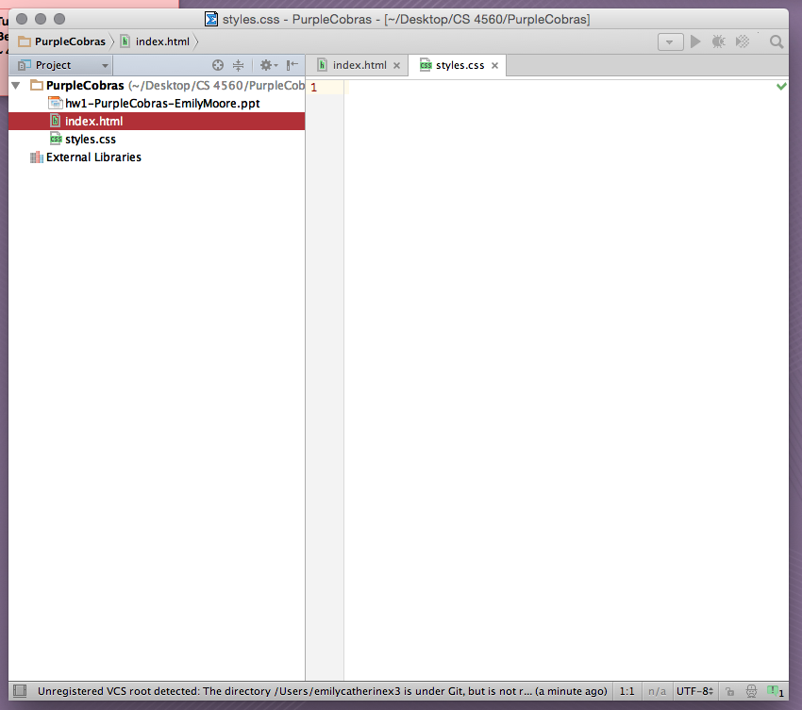
Technologies
WebStorm
“The smartest
JavaScript IDE”

Slide 6
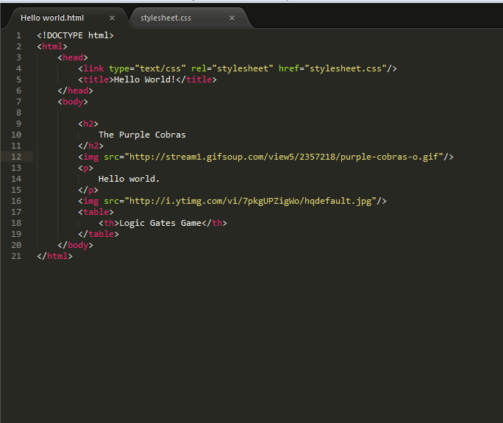
Technologies
Sublime Text 2
Text Editor

Slide 7
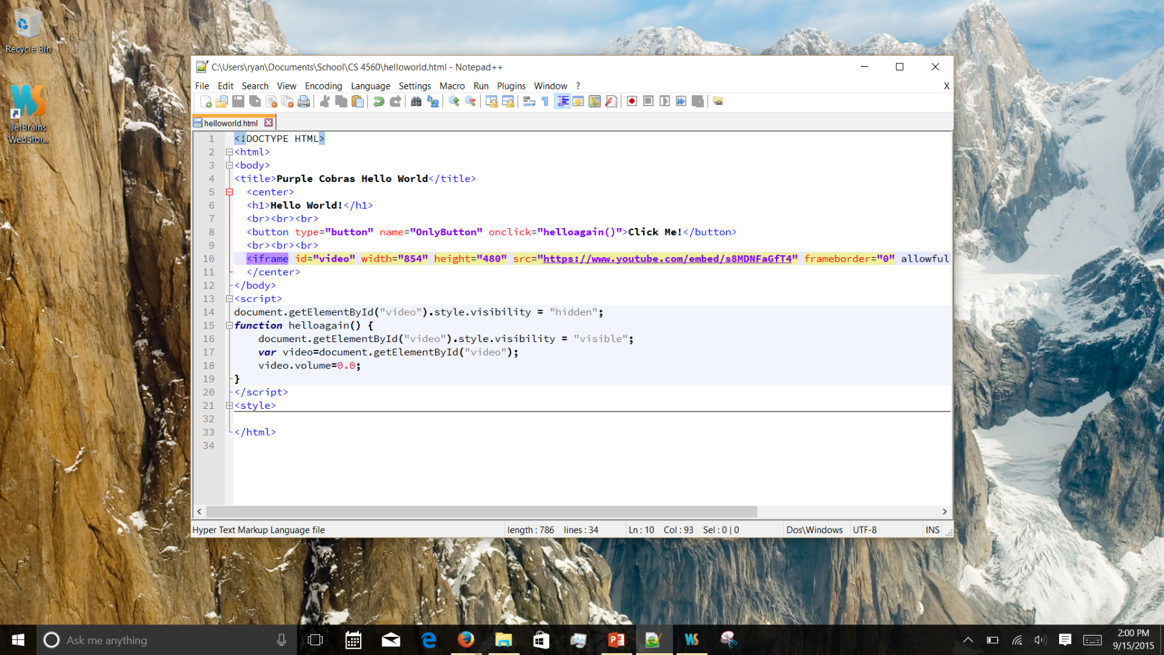
Technologies
Notepad++

Slide 8


Technologies
Google Chrome

Slide 9
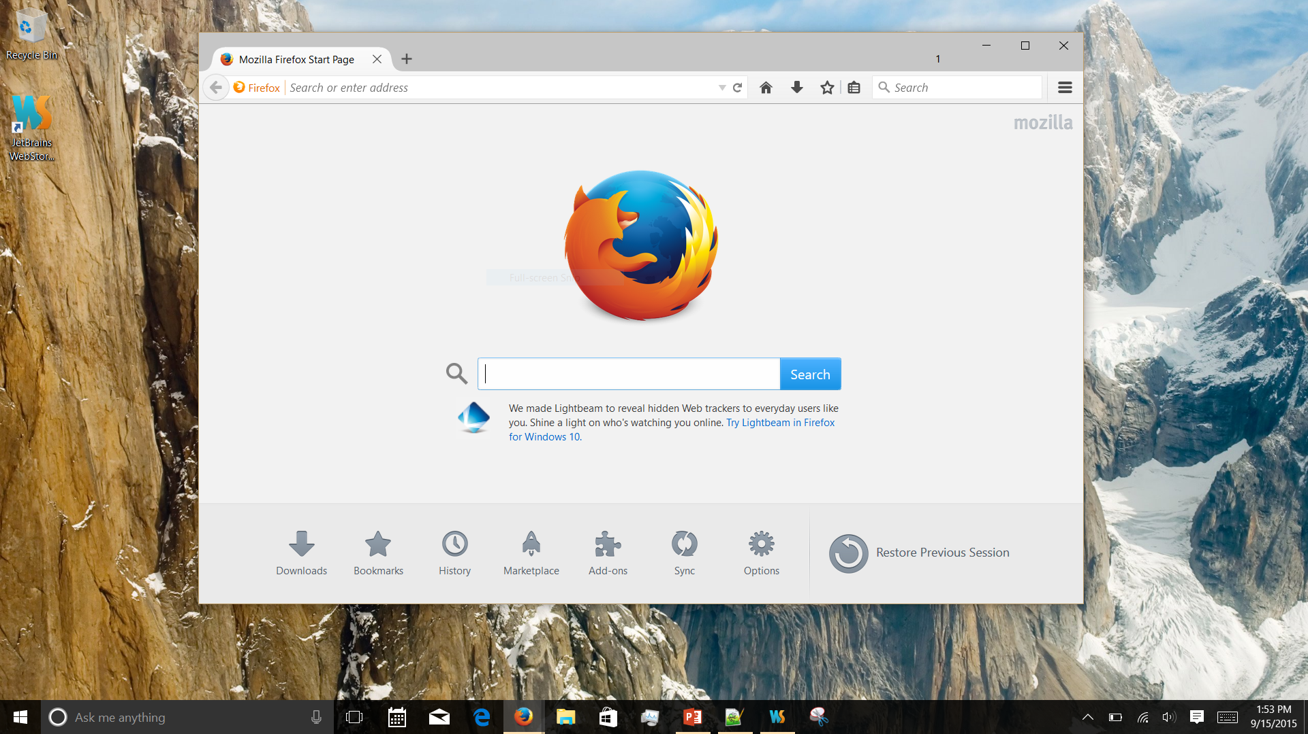
Technologies
Firefox

Slide 10
Technologies
JavaScript
HTML
CSS

Slide 11
Libraries
D3.js
D3plus.js
Processing.js
YUI Library

Slide 12
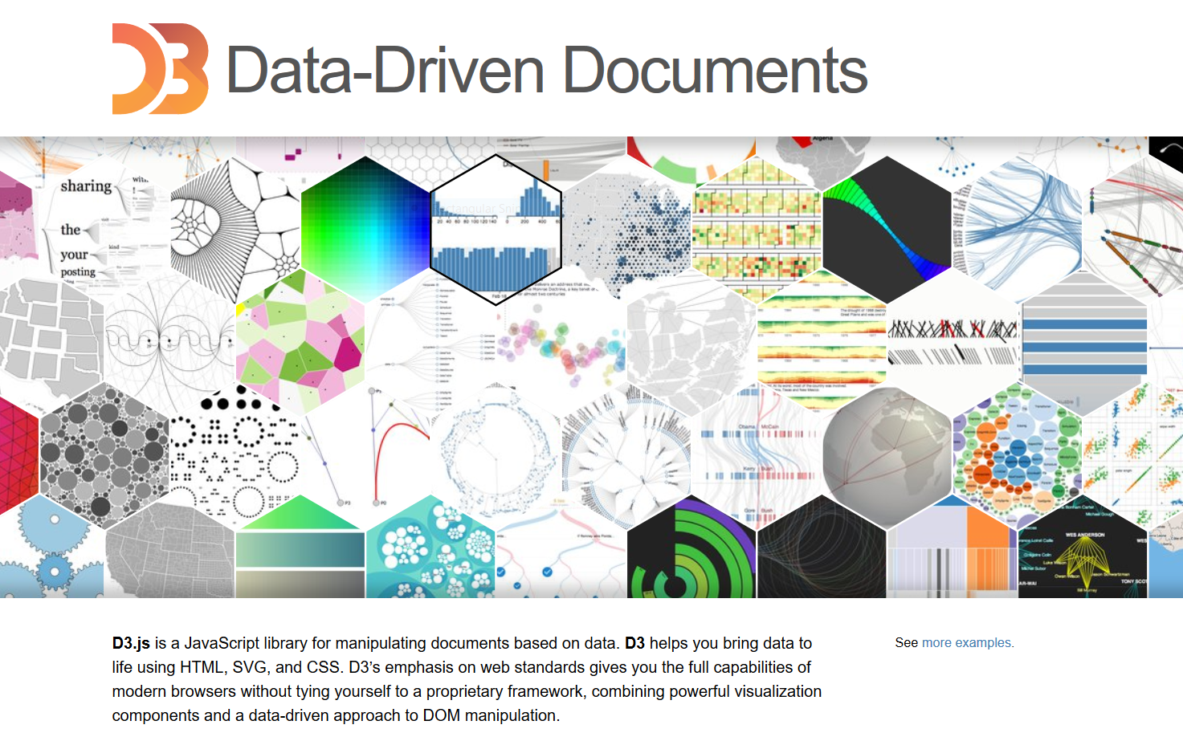
D3.js

Slide 13
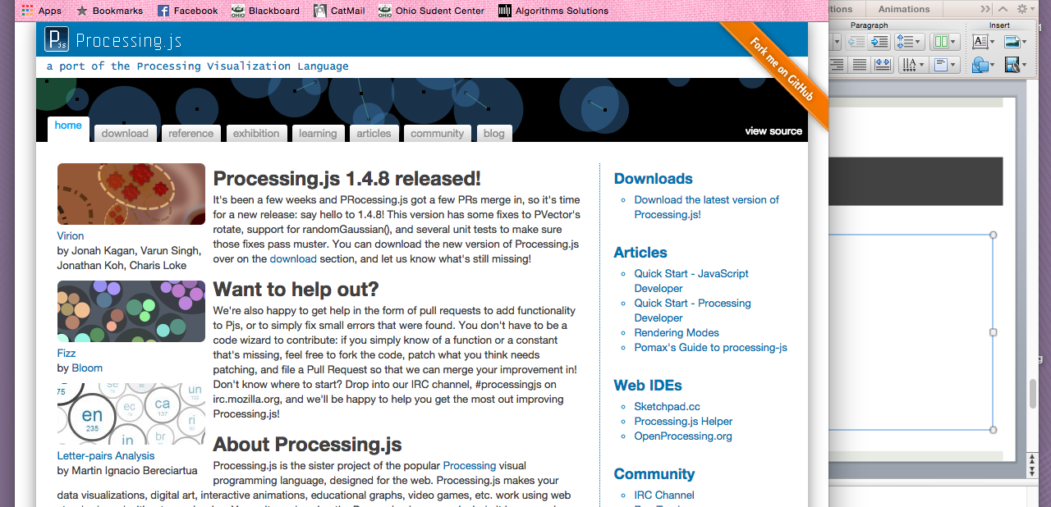
Processing.js

